Slide 1
COSC368-21S2 - Humans and Computers Lab 5: Sketching Interactions
Group Members:
Ted/Kaishun Yang(kya31)
Andy/Tawatchai Holmes(tho78)
Yoseph Bogale(ymb12)

Slide 2
Goals
Establishing a connection between the devices.
Selecting and sharing photos.

Slide 3
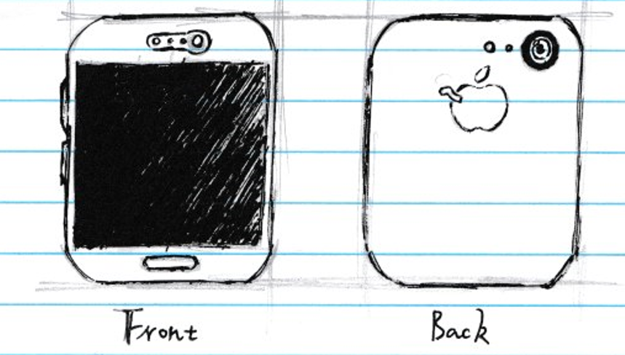
Device introduction
These two devices share identical features for photo transferring, each has a touchscreen, a main button, an on-off button, blue-tooth, wireless, GPS, proximity sensor, gyroscope, magnetometer, and an accelerometer.

Slide 4
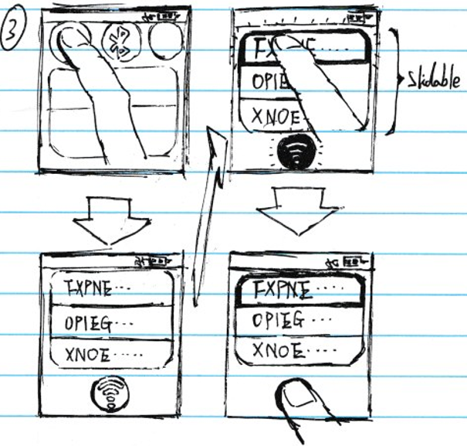
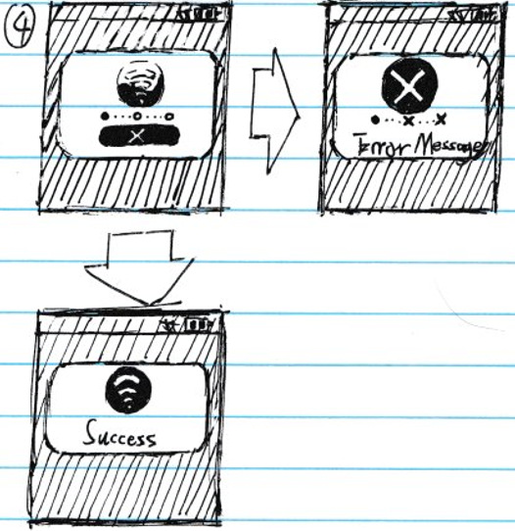
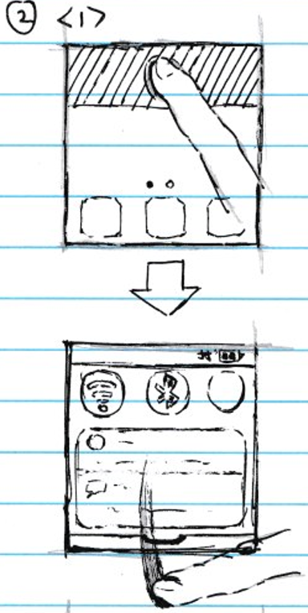
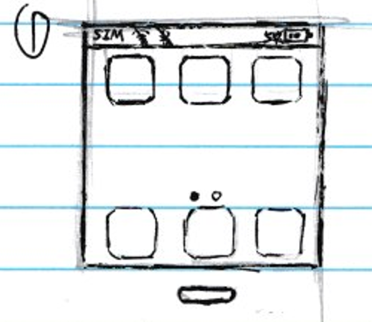
Establishing connection(1)
(1)Pressing on/main button to enter the home page
(assuming there’s no connection at the beginning, and no security measure like lock screen)
(3)Selecting Wi-Fi icon and it will jump into the Wi-Fi connection page, where has all the nearby Wi-Fi shown in a slidable list. After clicking a connection, the Wi-Fi button and the edge of connection, were dull and dim, will glow with green light. Then, clicking highlighted connection button to proceed. However if user wish to clear selection, clicking anywhere out of list and connection button will do.
(4) A connection window will appear in the middle of screen and show connecting process. Once the process is finished(either success or fail), the window will disappear after 2 seconds automatically. If connection is succeeded, it will come back to home page, otherwise, it will go back to connection page
(2)Using one finger to tap on one third area at the top of screen, and then slide down the window that include Wi-Fi, Bluetooth, etc.

Slide 5
Establishing connection(1) Cont.
Strength:
(1) Simple and clean, user could quickly find the correct action to achieve their goal as the design is commonly approachable in the real-world environment.
(2) It’s easier for user to navigate thanks to the visual cue like glowing connection buttons and many other well-used real-world symbol. It’s friendly to people with different skill level as an example people who can’t read can still recognize the symbol.
(3) it reduce the potential clicking errors by utilizing bigger buttons according to Fitt’s Law. That will increase the efficiency as well.
Weakness:
(1) It’s expensive and exhausting to build and implement for designer.
(2) It’s not an exciting design.
(3) it can create wrong predicts of user at step two and three, since there’s no instruction to explain why do users need to do slide and how to scroll the list.
(4) it is UI inaccessible for people who suffer from Deuteranomaly(red-green colour blindness).

Slide 6
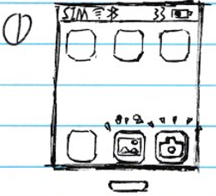
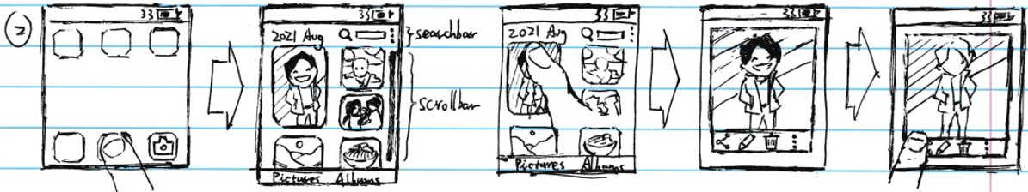
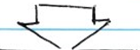
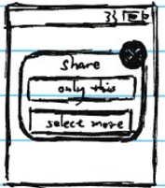
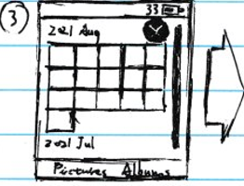
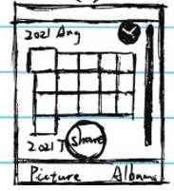
Selecting and Sharing(1)
(1)home page
(this time we assume the connection has been accomplished).
(2) Clicking gallery to get access to picture section that stored all saved photos.
Photos are sorted into two type which is show individually in picture section at the bottom left corner and accumulatively in album section at the bottom right corner. It also has a scrollbar to help user navigate and a search bar as a convenience for finding photos.
Clicking a random photo user want to share, then a photo editing page will show up.
Pressing the leftmost icon at the bottom to select sharing type.
(3) If user choose to “select more”, photo will be sorted in album type and a cancel button will appear on the top right corner. As soon as user select one photo, the selected photo will be slightly amplified and share button will come out at the mid bottom. And if user click photo again, they will come back to normal.

Slide 7
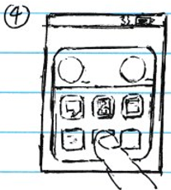
Selecting and Sharing(1) cont.
Strength:
This design is very popular that allows users to match their user model to system image.
Again, this design use many visual cue to avoid errors such as cross sign for cancel button, and the feedback about clicking photos in step 3 is also satisfying.
This design has two types of ways to let user perceive the photos, thus in picture section, it reduce the cognitive load by displaying photo with different sizes and enhance the detail of photos. And in album section, it’s functionally consistent to increase the efficiency and learnability.
Weakness:
The step two has way too many steps and distractions, both lead interface complexity increase.
The visual clarity of edit button at step two(three dots align in vertical after search bar) is not good enough.
In album section, it takes user longer time to find photos due to lack of search bar.
It can be rather frustrating for user to find share function in step two as double click and long press picture won’t work, that’s contradictory to some of users’ user model.
If user intends to share one photo from step two or to share multiple photos from step three, this page will be on the screen. User can send photo through contact, message and official media without any third party platforms.

Slide 8


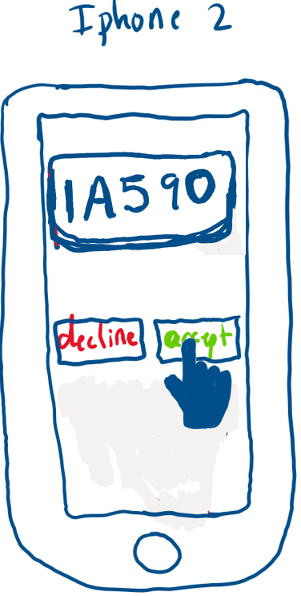
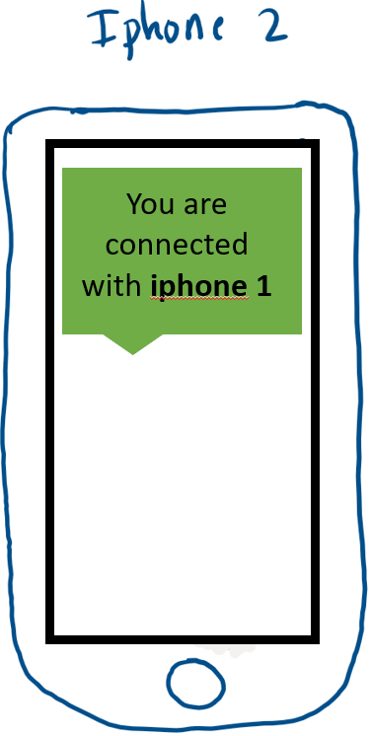
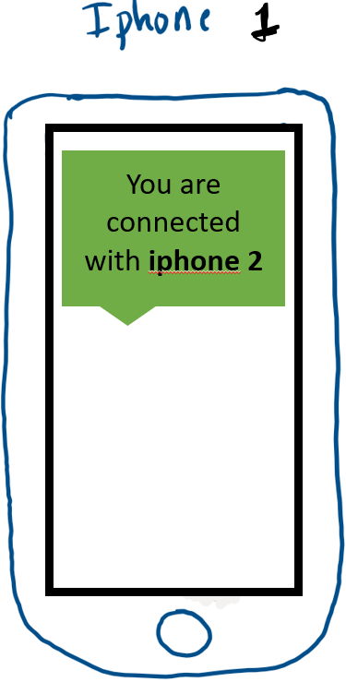
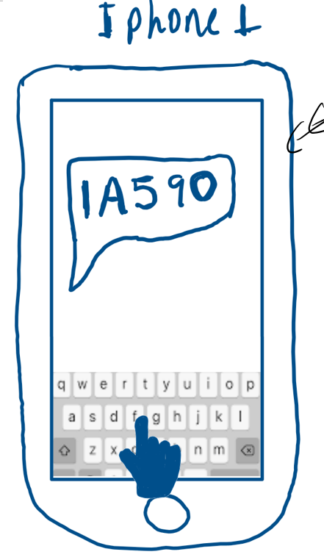
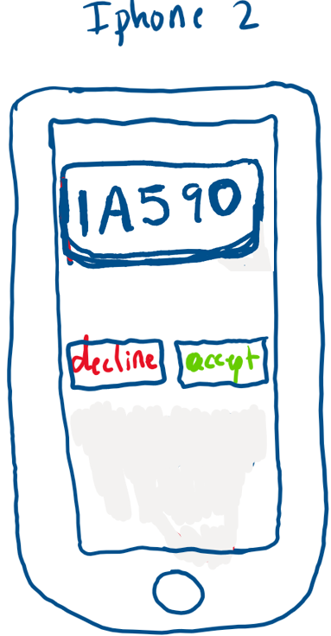

Establishing connection(2)
(1)Device 1 sends an ID to Device 2.
(2)Device 2 receives the message and its user are able to choose “accept” or “decline”
(3) If user choose to accept ID, a message box will show on the screen of both devices simultaneously meaning the connection has been established

Slide 9
Establishing connection(2) cont.
Strength:
Catching visual cue, and each button fits user’s predicts.
Supporting long distance photo transferring.
Weakness:
It’s confusing without instruction at step 1.
Boring design.

Slide 10
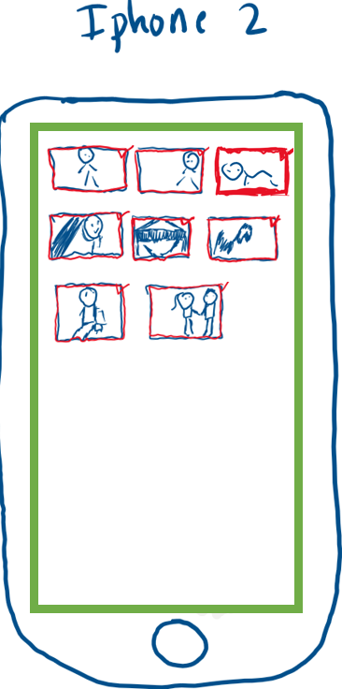
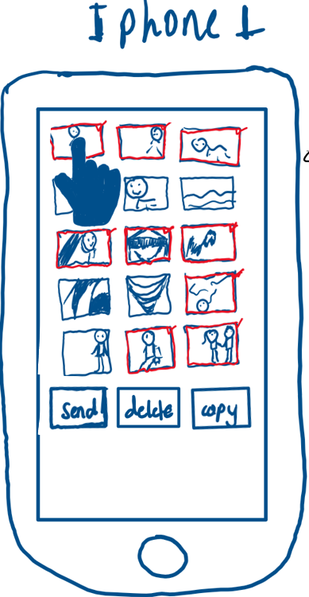
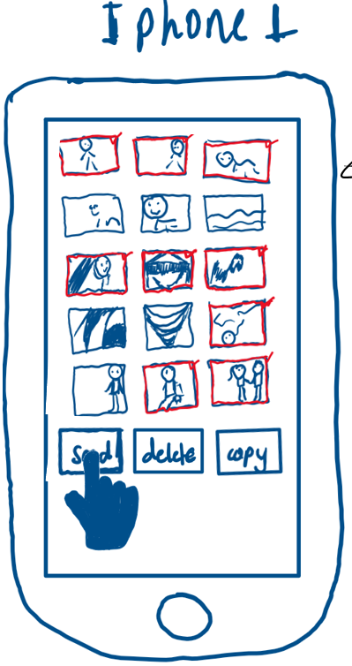
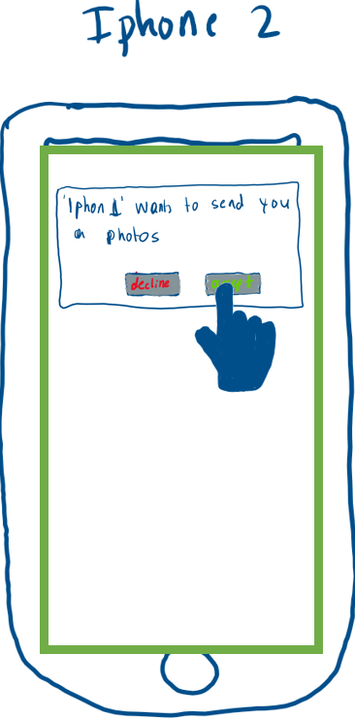
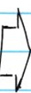
Selecting and sharing(2)
(1)Open the gallery and select all the images user want to send.
(2)After selection is finished, pressing send button at bottom.
(3) User of another device will obtain a message window that require user to accept or decline images.
(4) If user of device 2 choose accept, device will start receiving images until there’s no more.

Slide 11
Selecting and sharing(2) cont.
Strength:
- It clearly shows the state transitions with a description at every state.
It’s simple clean design that allow user to navigate easily.
It has explicit button setting to help user to understand.
Weakness:
The image state is confusing without instructions
it’s unfriendly to some group with different skill level, for example, people who don’t speak English can hardly understand the meaning of buttons without making mistakes

Slide 12
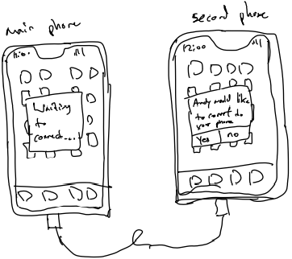
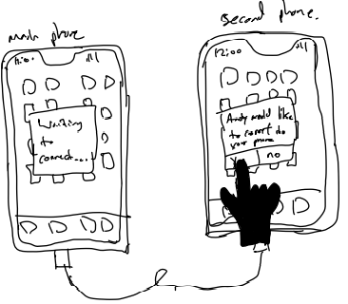

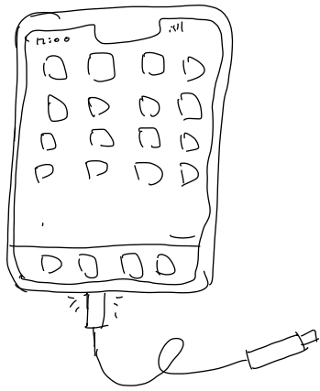
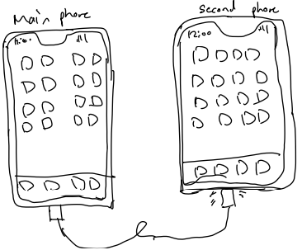
Establishing connection(3)
(1) -Connect one end of the USB-C into your main phone
(2) -Connect the other end of the USB-C to the second phone
-After connecting the USB-C to the second phone a pop up will appear on the second phone that says "... would like to connect to your phone". For the first phone a "waiting to connect...." will pop up
-The user on the second phone can choose whether they want to connect to the main phone or not

Slide 13
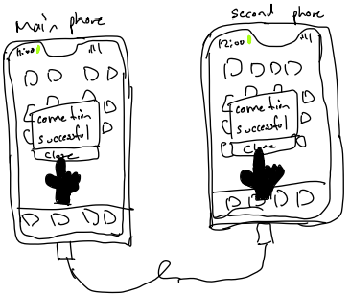
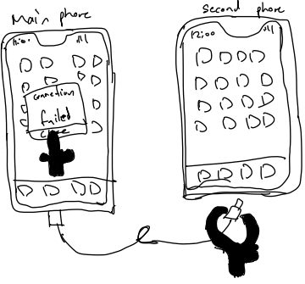
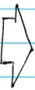
Establishing connection(3) const.
Strength:
The connection is very secure and strong
The connection is very fast to transfer stuff through wire
Can connect phone with no internet or somewhere without service/network
Weakness:
The user need to carry a USB- C wire around for if they want to connect to other users
Other user phones need to have a USB-C Charging port to be able to connect
Slow if user want to send Photo to everyone
(3) - If user on second phone click on yes. A "Connection successful" pop up will show and both user can click on "close" to close the pop up. There also will be a green circle/oval top left of the phone, meaning that both phone are connected
-If user on second phone click on No, a pop up saying "Connection failed" will be only on the main phone. The user on the second phone can remove the USB-C Cable

Slide 14
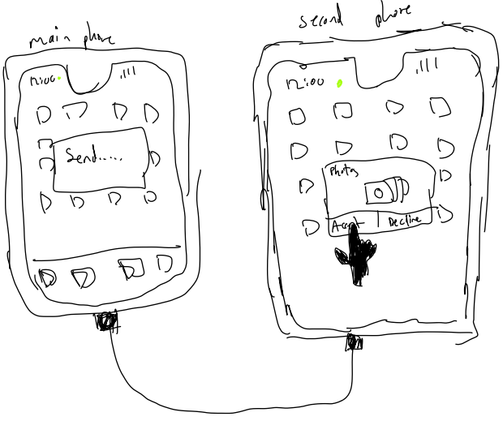
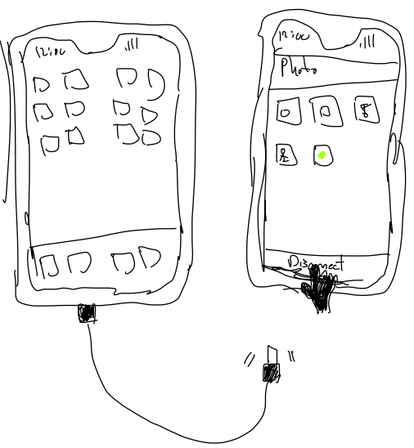


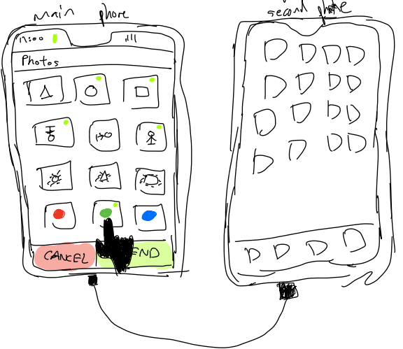

Selecting and sharing(3)
(1) User on main phone can select photos by clicking on the photo they want to send, then click on send
(2) User on second phone can decide to accept or decline the photos that's been sent from the main phone, If they press decline the connection will be lost and can remove the USB-C cable.
After clicking on Accept, second phone user can click on disconnect to disconnect from the main phone after the photo's been sent.

Slide 15
Selecting and sharing(3) cont.
Strength:
- Green dot shows which photos are selected to user knows
- Simple design and very popular amongst the users
Weakness:
- Too much information on one screen for user to look at
- User may need to scroll through a lot of photos to choose the right one

Slide 16

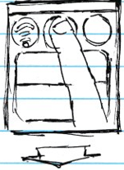
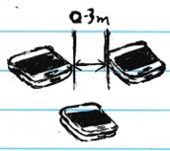
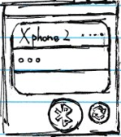
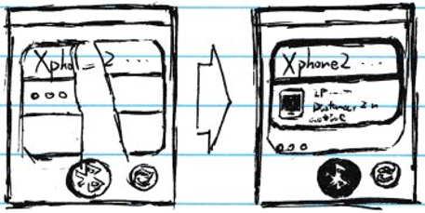

Establishing connection(4)
(3)Users of two devices need to turn on Bluetooth by clicking the icon first, and the distance between two devices should be no more than 3 meters in a low data transmission environment. If these are operated correctly, one device will be able to detect the another device in the list, otherwise user can use refresh button on the right of Bluetooth icon button to reconnect. Once the device is successfully detected, clicking it will show a small window that include details of clicked device down below, meanwhile the Bluetooth icon and chosen device will be highlighted.
(1)Pressing on/main button to enter the home page
(assuming there’s no connection at the beginning, and no security measure like lock screen)
(2)Using one finger to tap on one third area at the top of screen, and then slide down the window that include Wi-Fi, Bluetooth, etc.

Slide 17

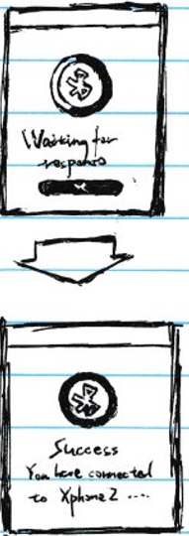
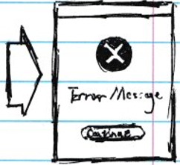
Establishing connection(4) cont.
Strength:
This design is simple, yet every move is reversible, as well as multiple visual cue, that can greatly improve learnability, efficiency and users’ cognitive recognition.
Can connect two devices without Wi-Fi, that will increase the accessibility.
Can transfer greater data than normal Internet. connection.
Weakness:
This design doesn’t support long distance photo transferring, and connection quality is unstable based on environment, also the speed of transferring large data can be slow.
Although the small detail window can be helpful, but it drastically increase cognitive load for user to observe.
This design doesn’t have status to feedback to users, that will cause confusion and discontent of user.
(4) A connection window will appear in the middle of screen and show current condition of connection, and a cancel button below. If connection is succeeded, it will come back to home page automatically after 2 seconds, otherwise, it will show an error message and a “continue” button that will transfer page to Bluetooth connection page.

Slide 18

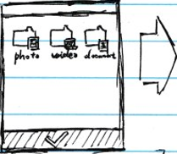
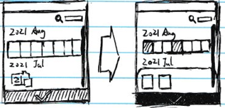
Selecting and Sharing(4)
(1)home page
(this time we assume the connection has been accomplished).
(2) Clicking gallery to get access to picture section that stored all saved photos.
Photos are sorted into two type which is show individually in picture section at the bottom left corner and accumulatively in album section at the bottom right corner. It also has a scrollbar to help user navigate and a search bar as a convenience for finding photos.
Clicking a random photo user want to share, then a photo editing page will show up.
Pressing the leftmost icon at the bottom to select sharing type.
(3) If user choose to “select more”, gallery page will come out with a tick button at the bottom, the next user should choose photo folder to select photos. As soon as user select one photo, the selected photo and tick button will be highlighted. And if user click photo again, photo will come back to normal and if none is selected, tick button will not be highlighted. After selection, click tick button to move on to step 4

Slide 19
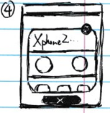
Selecting and Sharing(4) cont.
Strength:
This design use even more visual cues than design 1, it’s beneficial for user to distinguish the feature of design and increase memorability.
This design has a sending box to contain selected photo, which can give users a general view of selected photo to help users to analyse and organise before sending them.
Step 4 has cleaner interface compared to design 1 because of better arrangement of recommended sending option(Bluetooth in the middle of screen).
Weakness:
Interface complexity doesn’t match domain complexity.
The photo are all in the same size, it’s difficult for user to differentiate a set of photos.
The photo block in step 3 is trivial, it’s a great distraction and cumbrance for navigation.
If user intends to share one photo from step two or to share multiple photos from step three, this page will be on the screen. User can send photo through Bluetooth and cancel the transferring by clicking X button at the bottom.

Slide 20

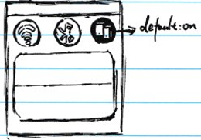
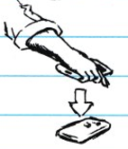
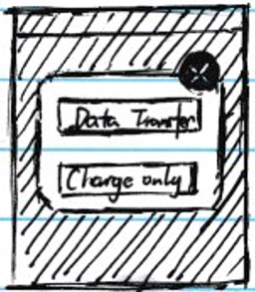
Establishing connection(5)
(3) Turn on the reverse charge if it’s off, then place the back of one device on the top of another device which face toward the ground. Wait until charging page appear will indicate the success of connection.
(1)Pressing on/main button to enter the home page
(assuming there’s no connection at the beginning, and no security measure like lock screen)
(2)Using one finger to tap on one third area at the top of screen, and then slide down the window that include Wi-Fi, Bluetooth, etc.

Slide 21
Establishing connection(5) cont.
Strength:
- Extraordinarily easy for user to implement.
It’s convenient and fun to use.
Its interface complexity is extremely low, and it doesn’t give user a high cognitive load.
Weakness:
It’s expensive due to hardware and technology.
Its system image doesn’t match users’ model quite well.
The reverse wireless icon can be confusing without instruction.
It requires two devices to be back-to-back each other, thus it has strict restriction of distance.

Slide 22


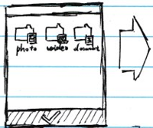
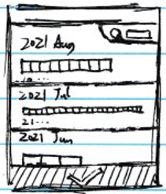
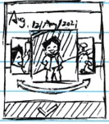
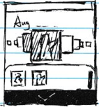
Selecting and sharing(5)
(1) The reverse wireless charging page
(2) Like before, user should click photo folder and then sorted photo block to select photos. The photos ,however, are presented in a 3D perspective, that means user can see almost everything of a photo but less than half of other photos. As soon as user select one photo, the selected photo and tick button will be highlighted. And if user click photo again, photo will come back to normal and if none is selected, tick button will not be highlighted. After click tick button, photos will be sent to another device automatically, and in the end come back to reverse wireless charging page.

Slide 23
Selecting and sharing(5) cont.
Strength:
User can be able to see the details of the current photo without cropping
It’s easier to compare two photos that’s next to each other
Weakness:
It’s hard for user to find or compare photos as most photos is either too tiny or too obscure to see.
Users cannot easily go back to the photos they have selected or seen before, that will make user to fear or their error, thus to reduce the learnability and efficiency.
The feedback is too weak to be noticed.

